Slide 1

Design and analysis of algorithms
Prepared by
Dr.S.Jenicka
Assistant professor senior grade 2
SCOPE-Analytics
VIT Vellore

Slide 2
Backtracking strategy
The principal idea in Backtracking is to construct solutions one component at a time and evaluate such partially constructed candidates as follows. If a partially constructed solution can be developed further without violating the problem’s constraints, it is done by taking the first remaining legitimate option for the next component. If there is no legitimate option for the next component, no alternatives for any remaining component need to be considered. In this case, the algorithm backtracks to replace the last component of the partially constructed solution with its next option.

Slide 3
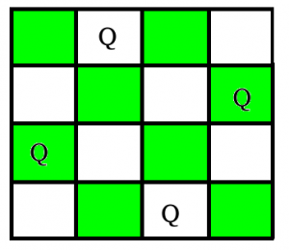
n-Queens problem
The N Queen is the problem of placing N chess queens on an N×N chessboard so that no two queens attack each other. For example, following is a solution for 4 Queen problem.

Slide 4
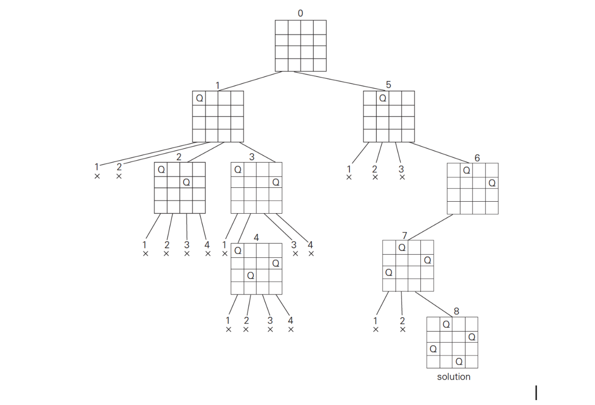
4-queens problem- Finding solution using backtracking strategy

Slide 5
n-Queens problem- Backtracking algorithm
1) Start in the leftmost column
2) If all queens are placed
return true
3) Try all rows in the current column.
Do following for every tried row.
a) If the queen can be placed safely in this row, then mark this [row, column] as part of the solution and recursively check if placing queen here leads to a solution.
b) If placing the queen in [row, column] leads to a solution then return true.
c) If placing queen doesn't lead to a solution then unmark this [row, column] (Backtrack) and go to step (a) to try other rows.
4) If all rows have been tried and nothing worked, return false to trigger backtracking.

Slide 6
Time complexity
Brute force solution for the N-queens problem has an O(n^n) time complexity because it explores all possibilities of nxn chess board
The time complexity of N-queens problem using backtracking is O(N!).

Slide 7
Sum of subsets problem
Subset sum problem is to find subset of elements that are selected from a given set whose sum adds up to a given number K.

Slide 8
Time complexity
O(2^n) where n is the number of elements in the given set. The number 2 signifies that there can be 2 options of either choosing or dropping any element from the given set.

